Slide 1
Single Working Taxpayer
Tom Andrews
Notes:
This lesson is used with NTTC Workbook Exercise Tom Andrews. It covers the following tax topics: Single filing status, Income (wages, interest, and unemployment), Adjustments (IRA Deduction and student loan interest), standard deduction, and retirement savings credit
Information for conducting this training lesson is contained in the Instructor Guide for Tax-Aide National Tax Training Committee Workbook (Workbook Instructor Guide).
Instructors should add, delete, or modify slides as necessary to meet their district training needs.
Instructors should direct the volunteers to review appropriate section of the Counselor Resource Guide (Pub 4012) whenever possible. If volunteers wish to take notes during class, they should note that Pub 4012 is a good place to record them.
Slides at the end of this presentation provide instructions for entering information for the various tax topic into TaxSlayer. Pub 4012 Tab O is emphasized as the best source for information on entering information into the software.

Slide 2
Single Working Taxpayer
This lesson will focus on a simple tax return for a typical single employed taxpayer
The following tax topics will be discussed:
Single Filing Status
Income: Wages, Interest, and Unemployment
Adjustments: IRA Deduction and Student Loan Interest
Standard Deduction
Credits: Retirement Savings Credit

Slide 3
Filing Status
Two criteria:
Marital status on last day of tax year
Federal definition – “married”
Legal marriage under laws of any state or country
Does not include civil unions or registered domestic partners
Persons living in the home (may or may not be dependents) or supported by taxpayer
Notes:
3
Instructors will introduce the general topic of Filing Status, but only Single will be discussed in this lesson
There is no requirement for taxpayers to substantiate their marriage – their statement that they are married is enough
U.S. state includes the district of Columbia and U.S. territories
Dependent: An individual who may be claimed as a dependent on another person’s tax return; that is, someone who meets all applicable dependency tests. Will discuss dependents in a later lesson

Slide 4
Filing Status Importance
Many tax items affected by filing status
Necessity to file a return
(Pub 4012 Page A-1 Chart A)
Standard deduction
(Pub 4012 Page F-1 Exhibit 1)
Tax rate bracket
Eligibility for certain credits
(e.g., Pub 4012 Page I-3 Step 3, and others)
Notes:
4
Instructors should direct volunteers to open and review the indicated sections of Pub 4012

Slide 5
Five Choices for Filing Status
Pub 4012 Tab B
Single
Married filing jointly (MFJ)
Married filing separately (MFS)
Head of household (HoH)
Qualified widow(er) (QW)
Notes:
Single Filing Status: Filing status that applies to a taxpayer who (1) has never married, or (2) is legally separated or divorced.

Slide 6
Filing Status: Single
Not married as of December 31
Married, but legally separated
NJ does not recognize legal separation, and IRS follows state rules. Therefore, legally separated in NJ cannot file single
There may be a more advantageous filing status if the taxpayer has dependents or other qualifying person (covered in later lesson)
Notes:
Legally separated involves a court document; a private contract is not enough

Slide 7
Questions
Answer Andrews questions 1 and 2

Slide 8
Income
Taxable vs Non-Taxable
Examples?
Turn to 4012 Page D-1
Earned vs Not Earned
Examples?
Turn to 4012 Page I-1
Notes:
Ask the class for examples of taxable vs non-taxable and earned vs not earned then direct them to Pub 4012 TABs to review

Slide 9
Questions
Answer Andrews questions 3 and 4

Slide 10
Income: Wages
Earned or Not Earned?
Wages are reported on form W-2
See Intake/Interview Form

Slide 11
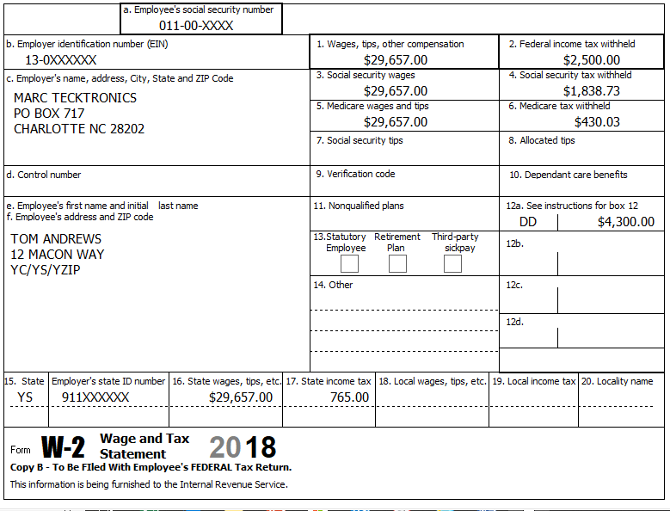
Form W-2
Verify current tax year
Notes:
Emphasize
Every labeled box must be input
Taxpayers sometimes bring in prior year W-2s by mistake so be careful

Slide 12
W-2 Box 12 codes
Often seen codes (26 possible codes):
D – Elective deferrals to a section 401(k) (Codes E through H are elective deferrals to other qualified plans)
DD – Cost of employer-sponsored health coverage
Careful: don’t confuse D and DD
Open Pub 4012 to Page D-6 to explore other codes
Notes:
Informational
Code D will add Form 8880 to the return (may need to make additional entries to it)
Code DD is informational only and does not affect the income tax return
All codes as shown on W-2 should be input into TaxSlayer (or “other” in box 14 data, if needed)
Instructors should point out the codes most often seen in their district
If box 14 has “401k”
Leave in box 14 and select from drop-down list that it qualifies or not for Form 8880 retirement savers credit (previous slide)

Slide 13
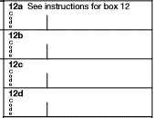
What’s Out of Scope on W-2?
With W-2 in hand determine if out of scope:
Box 12
Code R – Archer Medical Savings Acct (MSA)
Code T – adoption benefits
Code Q – nontaxable combat pay (unless certified for Military)
Code W – employer contribution to Health Savings Acct (unless certified for HSA)
Notes:
This is an excellent opportunity to introduce Volunteers to the Tax-Aide Scope Manual

Slide 14
What’s Out of Scope on W-2? (cont)
Ministers/church workers (special tax rules)
Very high earned income that is subject to the additional Medicare tax
MFJ: $250,000
MFS: $125,000
S, HoH or QW: $200,000
Notes:
Ministers or certain church works
This may be noted in box 14
The additional Medicare tax (Form 8959) is out of scope
Married filing jointly..........$250,000
Married filing separately........$125,000
Single, Head of household, or Qualifying widow(er) $200,000

Slide 15
Questions
Answer Andrews questions 5 and 6

Slide 16
Income: Interest
Earned or Not Earned?
Interest sources:
Bank and credit union deposits
Bonds (corporate or government)
Money loaned out
Check the Intake/Interview Form

Slide 17
Income: Interest – Tax Forms
Form 1099-INT or 1099-OID
Brokerage Statement
Schedule K-1 (Covered later)
No tax form from payer
Seller financed mortgage interest income
Private or foreign payer
Interest less than $10
Notes:
Credit unions may call their interest “dividends” – but it’s really interest and reported as such

Slide 18
Income: Interest
All interest must be included in the return
Taxable and Tax-exempt
Other calculations can be impacted

Slide 19
Income: Interest
All interest is taxable except interest from
State or municipal obligations; including
D.C.
U.S. possessions
See Pubs 4491 and 4012 for others
U.S. obligations (T-Bills, Savings Bonds, etc.) are fully taxable for federal tax but exempt from state tax
Notes:
Informational:
Some treasury bonds may produce exempt interest for federal purposes
Certain “EE” or “I” bonds used for qualified education purposes
Requires Form 8815 – which is out of scope

Slide 20
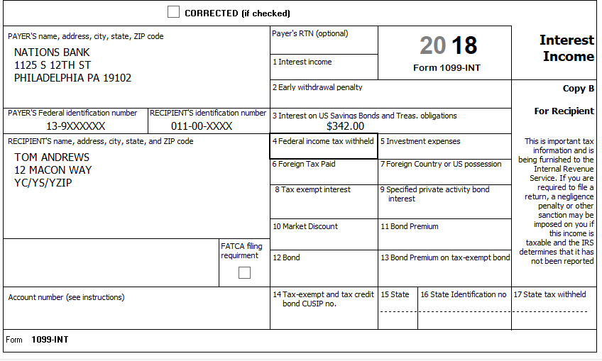
Income: Interest – Form 1099-INT
FATCA is out of scope
OOS
OOS
OOS
OOS
Notes:
FATCA stands for Foreign Account Tax Compliance Act.
Bond Premiums and Discounts Box 10 -13 are out of scope.

Slide 21
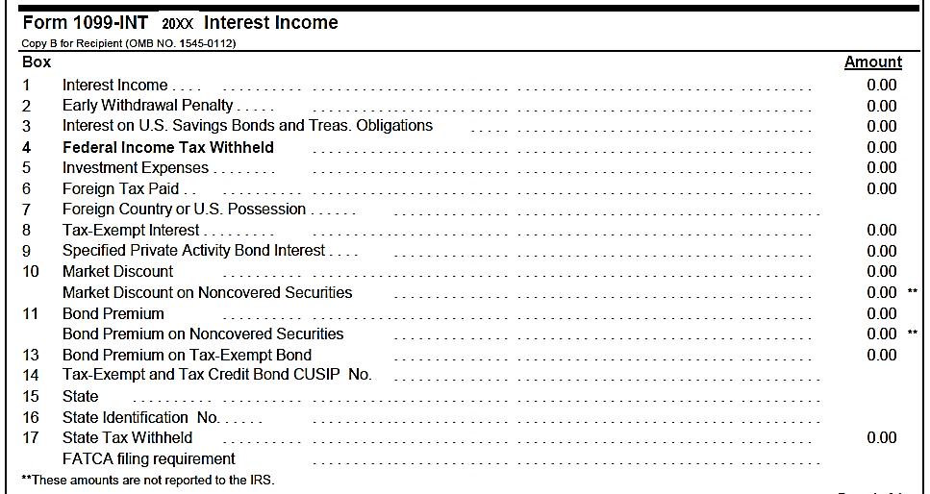
Income: Interest – Sample Brokerage Statement
Lines 10-13 are out of scope
FATCA is out of scope
Notes:
Emphasize
All the information as in 1099-INT boxes
Format varies by payer

Slide 22
Questions
Answer Andrews questions 7 - 9

Slide 23
Income: Unemployment Compensation
Earned or Not Earned?
Taxable or Non-Taxable?
Generally taxable (may not be State taxable)
Received under federal or state laws
Check the Intake/Interview Sheet
Notes:
Instructor Notes:
Ask the class the questions and have them refer to pub 4012 to verify
If a taxpayer does not have their 1099-G, there is a phone number for most states to call where they can find out what they received and their withholding if any. They will need the payer and the payer’s Federal identification number and address

Slide 24
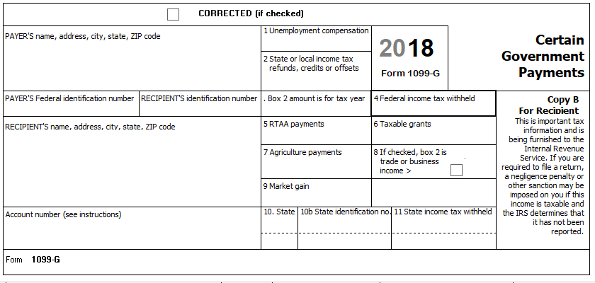
Income: Unemployment – Form 1099-G
Boxes 7-9 are out-of-scope
Out of Scope

Slide 25
Questions
Answer Andrews question 10

Slide 26
Adjusted Gross Income
Total Income
minus Adjustments
=
Adjusted Gross Income (AGI)
Notes:
26
AGI is important for many tax items
Entitlement to credits – EIC, PTC, ACTC, education credits
Entitlement to deductions/adjustments – IRA deduction, tuition & fees (if extended), medical, miscellaneous (for TY 2017 and before)

Slide 27
Adjustments: IRA Deduction and Student Loan Interest

Slide 28
Adjustments: IRA Deduction
Allowable contribution can never be more than taxable compensation
Taxable W-2 income, self-employment income, and alimony
NOT interest, dividends, pensions, scholarships, unemployment, Social Security
Notes:
“Compensation” is different than earned income!

Slide 29
Adjustments: IRA Contribution – Limitations
Age limits
For traditional IRA – under 70½ as of the end of the year
For Roth IRA – no age limit
Contribution and deduction limit
$5,500 ($6,500 if age 50 or over)
If more than one IRA, allowable contribution amount applies to all IRAs (including Roths)

Slide 30
Adjustments: IRA Contribution – Limitations
If taxpayer participates in an employer’s plan and/or AGI is too high
Some or all of traditional IRA contribution may be nondeductible
Allowable contribution in excess of deduction becomes basis in the IRA (Form 8606)

Slide 31
Adjustments: IRA Contribution – Limitations
Roth IRA also has a modified AGI limit (regardless of employer plan)
$133,000 for single filing status
Different limits for other filing status
When MAGI is over this amount, it’s ALL an excess contribution
Notes:
Other filing statuses includes single, head of household and MFS that did not live with spouse at any time during the year

Slide 32
Adjustments: IRA Contribution
Taxpayer has until the April due date of the return to make a contribution for the current tax year and still include on this year’s return

Slide 33
Adjustments: IRA Contribution – Excess Contribution
If there is an excess contribution
Have until due date of the return to withdraw excess amount
Otherwise, subject to 6% penalty each year until remedied
Out of scope
Notes:
A contribution of more than the allowable contribution is an excess contribution subject to a 6% penalty annually until the excess is cured (F 5329)

Slide 34
Questions
Answer Andrews quiz questions 11 and 12

Slide 35
Adjustments: Student Loan Interest
Pub 17, Ch 19
Interest paid on qualified student loan for post secondary education expenses
Qualified loan:
Expenses of taxpayer, spouse, or dependent when loan originated
For education expenses paid within reasonable time since loan was opened
For education provided when student enrolled at least ½ time in degree program

Slide 36
Adjustments: Student Loan Interest
Qualified Loan (cont.)
Loan cannot be from relative
Taxpayer cannot file MFS
Taxpayer not a dependent on someone else’s return
Loan cannot be from qualified retirement plan
Taxpayer must be liable for the loan

Slide 37
Adjustments: Student Loan Interest – Limitations
Maximum $2,500 per year
Phases out as AGI increases
If >$600, should receive Form 1098-E

Slide 38
Question
Answer Andrews question 13

Slide 39
Deductions
Subtractions from a taxpayer’s adjusted gross income (AGI)
Reduces amount of income taxed
Most taxpayers have a choice
Standard deduction
Itemizing deductions
Use type of deduction that results in lower tax

Slide 40
Deductions: Standard Deduction
Fixed reduction of AGI based on:
Filing status
Age (65 or older)
Blindness
Dependency
Standard subject to change each year
Turn to 4012 Pages F-1 and F-2 and examine possibilities for a single working taxpayer
40

Slide 41
Credits
Credits reduce tax dollar for dollar
Non-Refundable vs Refundable
Non-Refundable - can reduce the tax liability to zero, but does not provide a refund of excess credit
Refundable - can reduce the tax liability to zero & provide a refund of excess credit

Slide 42
Credits: Retirement Savings Contributions Credit
Non-Refundable
For low-income taxpayers who made contributions to qualified retirement plan
Shown on Form 8880
Review Decision Tree and Reminders (Pub 4012 Tab G)
TaxSlayer computes credit – verify input data

Slide 43
Credits: Retirement Savings Contributions Credit
Ask if taxpayer made (or plans to make) contribution to a retirement account
Might not show on any tax document

Slide 44
Credits: Retirement Savings Contributions Credit
Form W-2 Retirement Savings Contribution
Entry in block 12 will generate Form 8880 automatically if qualified
Entries in block 14 require taxpayer interview to see if entry qualifies for Form 8880 (must be a VOLUNTARY contribution)

Slide 45
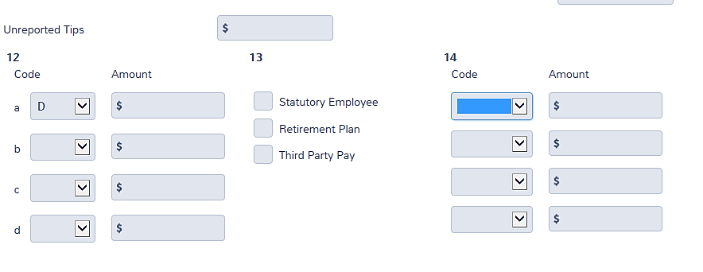
Credits: Retirement Savings Contributions – W-2 Box 12
Codes D, E, G, AA*, BB*, and EE* will go to Form 8880
**These codes don’t show on the 8880 input screen

Slide 46
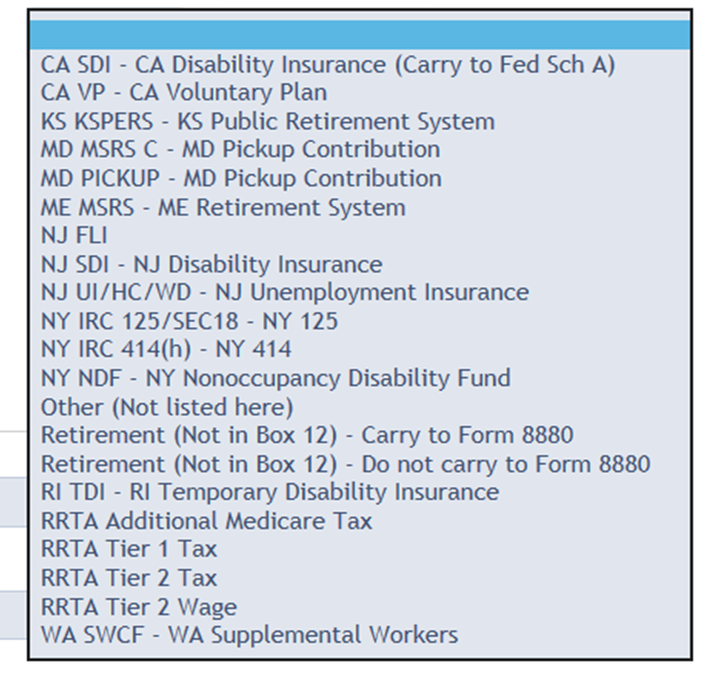
Credits: Retirement Savings Contributions W-2 Box 14
For voluntary contributions, choose this code
For mandatory contributions, choose this one

Slide 47
Questions
Answer Andrews questions 14 and 15

Slide 48
Single Working Taxpayer – NJ Considerations
This section will focus on NJ aspects of a simple tax return for a typical single employed taxpayer
The following tax topics will be discussed:
State Interview Aids and Guides
State Basic Info
Filing Status
Income: Wages (Box 14), Interest (Savings Bonds), Unemployment
NJ Property Tax deduction/credit (for Rent)

Slide 49
State Interview Aids – The New Jersey Checklist
Document for NJ preparers developed by and available from TaxPrep4Free.org
Document is a two-page entry form which can be printed and filled out during the interview process and while the Federal return is being prepared
Assists in collecting and documenting data needed when preparing the State return and in the QR process
Indicates where to enter collected data in the State Section

Slide 50
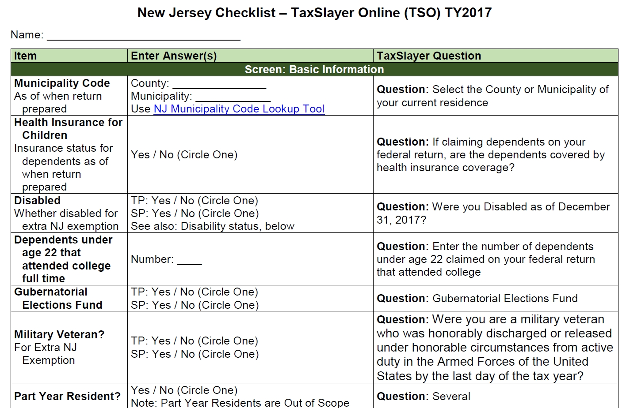
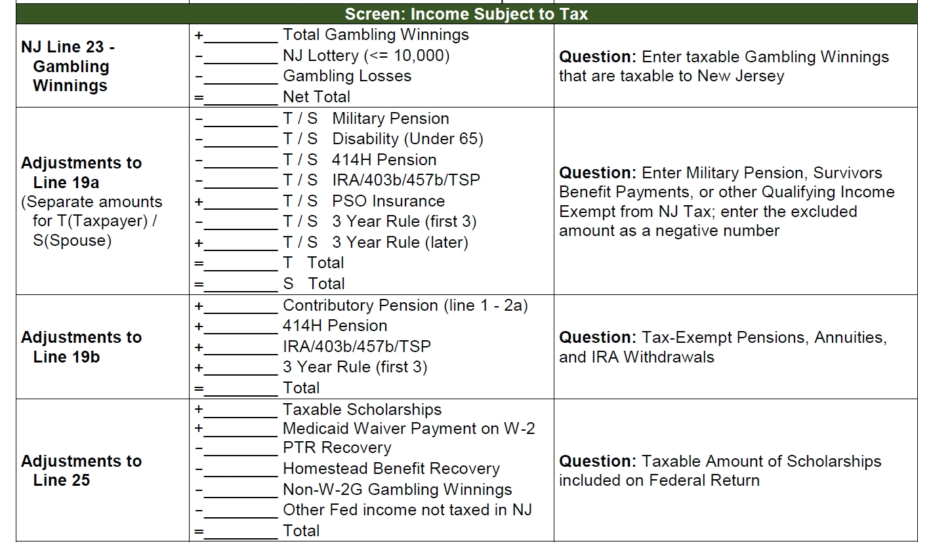
State Interview Aids – The New Jersey Checklist
Page 1

Slide 51
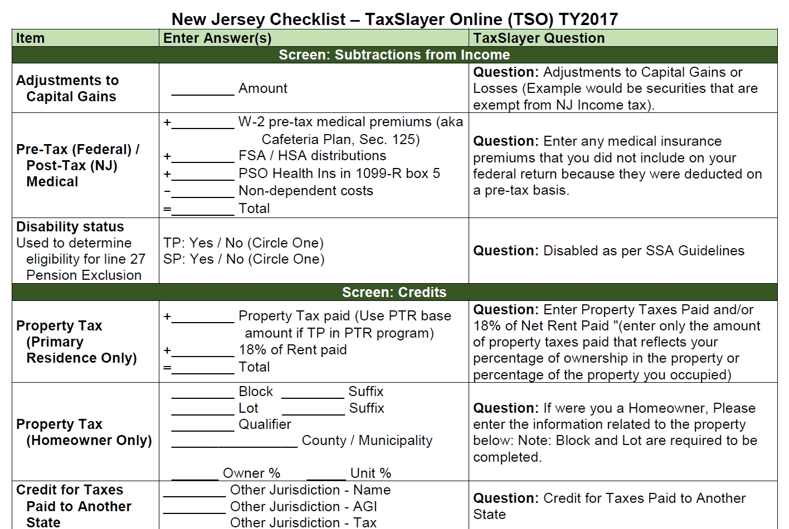
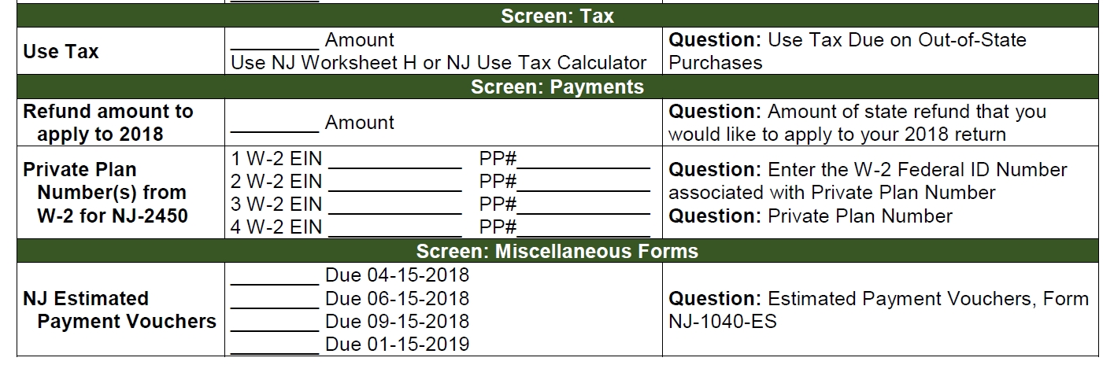
State Interview Aids – The New Jersey Checklist
Page 2

Slide 52
State Interview Aids – NJ Special Handling
Document for NJ preparers developed by and available from TaxPrep4Free.org
NJ specific topics are discussed with tax law summary explanations on what to record on the NJ Checklist for later entry
Additional presentations, videos and demos are also available for these topics

Slide 53
Filing Status – NJ Considerations
NJ follows the same filing status as Federal.
Except
For Civil Unions (OOS) (Discussed in Caldwell problem)

Slide 54
NJ State Basic Information
TaxSlayer starts a NJ return after the taxpayer Personal Information in the Basic section is entered Three questions are asked:
Municipality code (Required)
Dependent health insurance coverage (Only if applicable)
Gubernatorial elections fund (Defaults to “No”)
Depending on circumstances, some additional basic information may be needed, such as Veteran Deduction eligibility
Entered after Federal return is completed

Slide 55
NJ State Basic Information – Military Veterans
Since 2017, a U.S. military veteran is eligible for a $3,000 exemption for the NJ Return
Honorably discharged or released under honorable circumstances from active duty any time before the last day of the tax year
Taxpayer and spouse get exemption if both are eligible veterans
Qualifying veterans only (not surviving spouses)
Must have provided official documentation along with an application form to the State Treasury before the return is filed
Conditional exemption can be given providing TP submits application immediately

Slide 56
Income: NJ Withholdings in W-2 Box 14
Allowable deduction on Federal Schedule A as State taxes (except for Private Plans, which will presented in the Baker problem)
Maximum contribution for state or local taxes can change each year
If one employer exceeds maximum contribution, taxpayer must contact employer for refund
State Unemployment Insurance (UI/WF/SWF) = NJUI
UI - Unemployment Insurance
WF – Workforce Fund
SWF – Supplemental Workforce Fund
State Disability Insurance (SDI) = NJSDI
Family Leave Insurance (FLI) = NJFLI
If more than one specified, add them together as “NJUI”

Slide 57
Income: Interest – NJ Considerations
Interest income in Box 1 is taxable for both Federal and NJ
Since interest on US government bonds is taxable for Federal, but not for NJ, must enter interest amount to be subtracted from NJ income

Slide 58
Savings Bonds and State Returns
About Savings Bonds
Federal debt securities to help pay the Federal debt
Interest is tax exempt by all states and political subdivisions
Reporting Savings Bond Interest
Reported on 1099-INT, Box 3
When entering in TaxSlayer, must specify tax-exempt amount and State

Slide 59
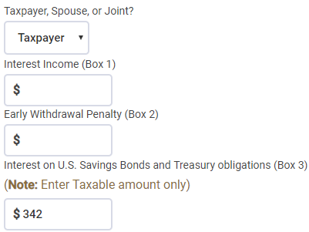
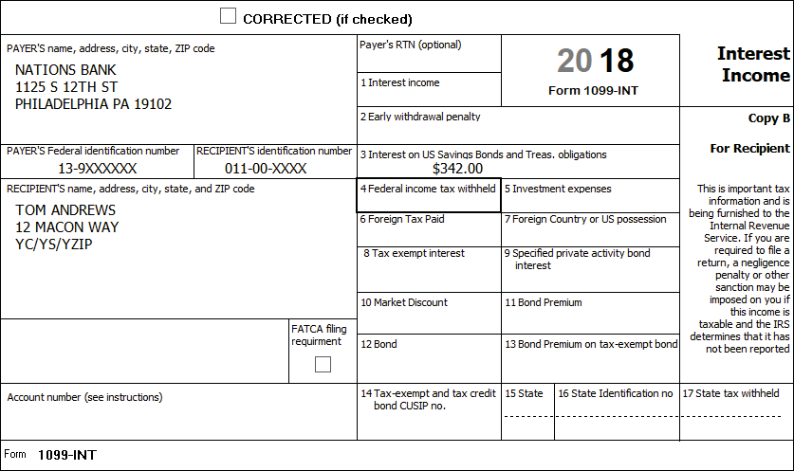
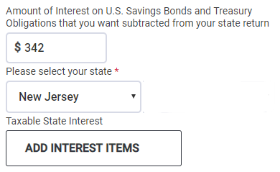
Reporting Savings Bonds
The amount in Box 3 is entered twice, once In the box provided for “Interest on U.S. Savings Bonds” and then in the box “that you want subtracted from your state return. Enter “New Jersey’ for State in drop-down box.
NTTC Training - TY2018

Slide 60
Income: Unemployment – NJ Considerations
Unemployment is taxable for Federal return
Unemployment is not taxable in NJ
Handled automatically
1099-G not mailed to taxpayer; must look up info on NJ Dept. of Labor website
Taxpayer must have a user name, password & PIN to view/print 1099-G

Slide 61
NJ Property Tax Deduction or Credit - Rents
NJ has several Property Tax relief programs
The programs and “what to do” are discussed in the Davenport problem
Tenants who pay rent are eligible for NJ taxable income deduction or tax credit, whichever is most beneficial
18% rent paid is considered as property tax for purposes of this benefit
Tax-exempt housing is excluded from this program

Slide 62
Questions
Answer Andrews questions 16 - 20

